Slide 1
Medicine Hat, Alberta: First City to end homelessness 2015 “HOUSING FIRST” 2009-2017
Access to Housing is a basic human right
Average homeless person costs govt $120,000 a year
With housing, the cost is $18,000 to house & support
NEW YORK TIMES ARTICLE 2017: Homeless find a Champion in Canada’s Medicine Hat (See the end)

Slide 2
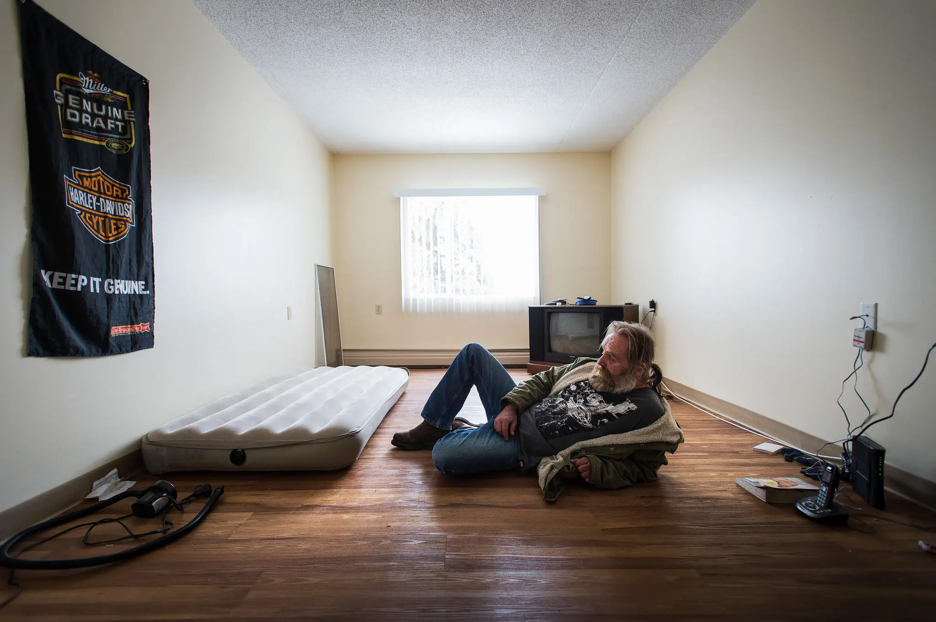
1. Stakeholders must be on board 2. What does Housing first mean?
MH Community Housing Society (MHCHS) working with
Community Council on Homelessness includes 20 stakeholders such as
Housing providers, police, private & public sectors, human services, a corrections rep
Housing First: provide a homeless person with housing first then offer supports
To deal with drugs, alcohol, medications & joblessness etc.
July 2019: 489 homeless, only 9% were seniors

Slide 3
Medicine Hat: population 63,000 city reliant on agriculture, gas industry
One of 7 cities in Alberta, incl. Edmonton & Calgary
MH had the lowest rents, but also the lowest income levels
People paying too much in rent (more than 30%)
US studies show it’s less costly to end long term homelessness than rely on expensive shelters, emergency health treatment, police and jail.

Slide 4
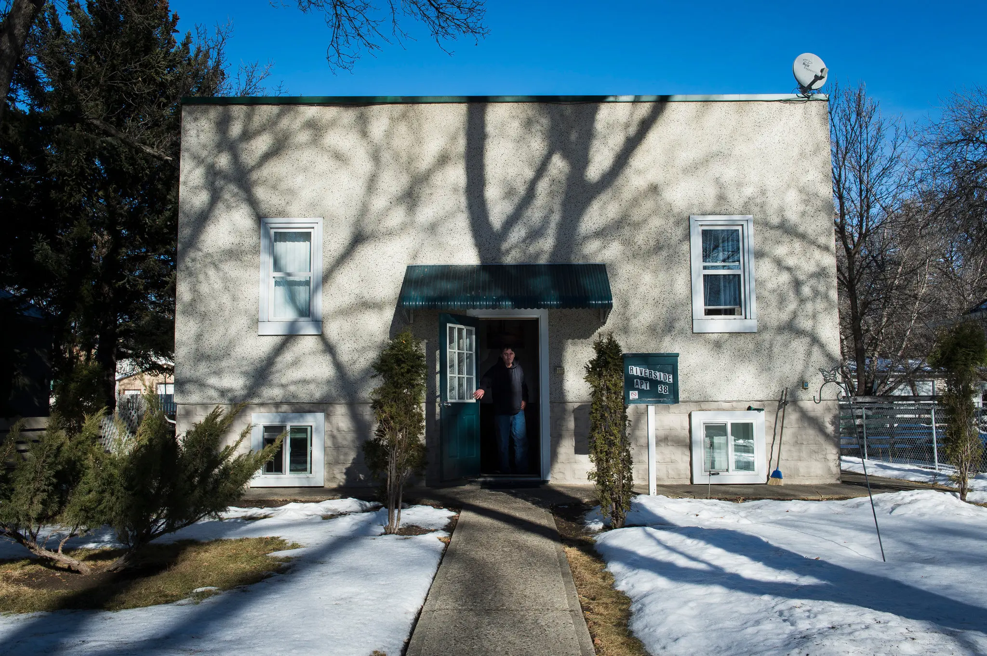
Considerations to create a strategy to end homelessness
Community owned effort, not one stakeholder
Broader vision of what is housing
Acknowledge tensions
Cater to diversity
Support from Govt, frontline agencies, business sector funders, community
Strong group of leaders necessary

Slide 5
WHAT you Can read
NY Times article: https://www.nytimes.com/2017/02/26/world/canada/homeless-canada-medicine-hat-housing-first.html
Recent Discussion with Medicine Hat mayor Linnsie Clark https://medicinehatnews.com/news/local-news/2024/01/19/clark-appears-on-cbc-to-talk-homelessness/
Homelessness in Canada, podcast with Medicine Hat’s Jaime Rogers https://postalcodechronicles.medium.com/16-homelessness-in-canada-with-jamie-rogers-6d50c9871497

